Slide 1

DESIGN AND ANALYSIS OF ALGORITHMS
Dr. Kashif Ayyub

Slide 2
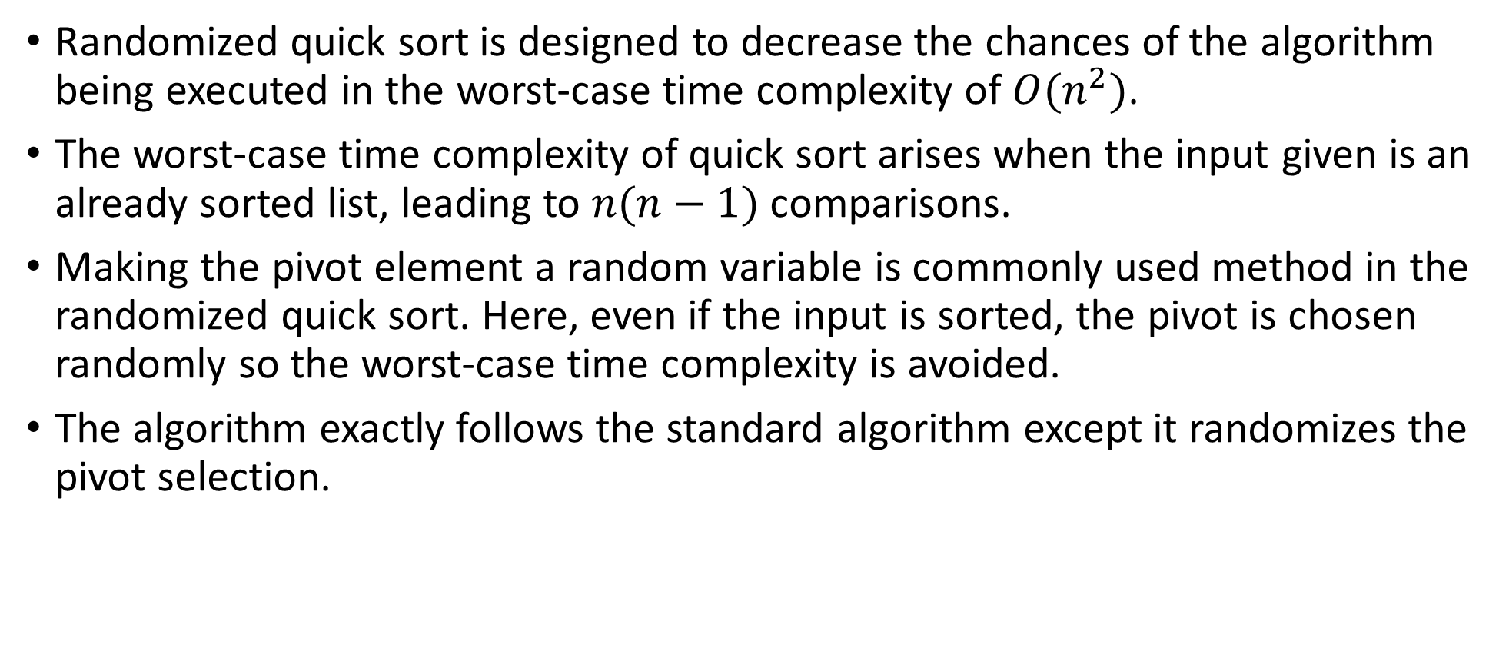
Randomized Quick Sort
Randomized quick sort is designed to decrease the chances of the algorithm being executed in the worst-case time complexity of $O(n^{2})$.
The worst-case time complexity of quick sort arises when the input given is an already sorted list, leading to $n(n−1)$ comparisons.
Making the pivot element a random variable is commonly used method in the randomized quick sort. Here, even if the input is sorted, the pivot is chosen randomly so the worst-case time complexity is avoided.
The algorithm exactly follows the standard algorithm except it randomizes the pivot selection.

Slide 3
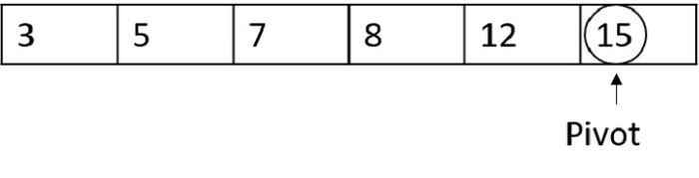
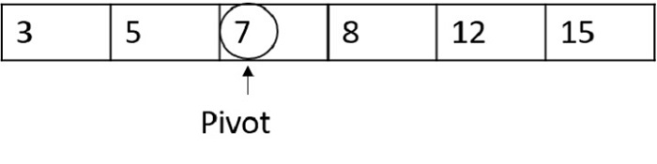
Randomized Quick Sort - Example
Let’s take a sorted list as an input for this example.
3, 5, 7, 8, 12, 15
Case-1
Considering the worst case possible, if the random pivot chosen is also the highest index number, it compares all the other numbers and another pivot is selected. Since 15 is greater than all the other numbers in the list, it won’t be swapped, and another pivot is chosen.
Case-2
If the random pivot function chooses 7 as the pivot number. Now the pivot divides the list into half so standard quick sort is carried out usually. However, the time complexity is decreased than the worst case.

Slide 4
What is a “heap”?
Definitions of heap:
A large area of memory from which the programmer can allocate blocks as needed, and deallocate them (or allow them to be garbage collected) when no longer needed
A balanced, left-justified binary tree in which no node has a value greater than the value in its parent
These two definitions have little in common
Heapsort uses the second definition

Slide 5
Why study Heapsort?
It is a well-known, traditional sorting algorithm you will be expected to know
Heapsort is always O(n log n)
Quicksort is usually O(n log n) but in the worst case slows to O(n²)
Quicksort is generally faster, but Heapsort is better in time-critical applications
Heapsort is a really cool algorithm!

Slide 6
Balanced binary trees
Recall:
The depth of a node is its distance from the root
The depth of a tree is the depth of the deepest node
A binary tree of depth n is balanced if all the nodes at depths 0 through n-2 have two children
n-2
n-1
n
Balanced
Balanced
Not balanced

Slide 7
Left-justified binary trees
A balanced binary tree is left-justified if:
all the leaves are at the same depth, or
all the leaves at depth n+1 are to the left of all the nodes at depth n
Left-justified
Not left-justified

Slide 8
Plan of attack
First, we will learn how to turn a binary tree into a heap
Next, we will learn how to turn a binary tree back into a heap after it has been changed in a certain way
Finally (this is the cool part) we will see how to use these ideas to sort an array

Slide 9
The heap property
A node has the heap property if the value in the node is as large as or larger than the values in its children
All leaf nodes automatically have the heap property
A binary tree is a heap if all nodes in it have the heap property
12
12
12
8
3
8
12
8
14
Blue node has heap property
Blue node has heap property
Blue node does not have heap property

Slide 10
siftUp
Given a node that does not have the heap property, you can give it the heap property by exchanging its value with the value of the larger child
This is sometimes called sifting up
Notice that the child may have lost the heap property
12
14
8
14
8
12
Blue node does not have heap property
Blue node has heap property

Slide 11
Constructing a heap I
A tree consisting of a single node is automatically a heap
We construct a heap by adding nodes one at a time:
Add the node just to the right of the rightmost node in the deepest level
If the deepest level is full, start a new level
Examples:
Add a new node here
Add a new node here

Slide 12
Constructing a heap II
Each time we add a node, we may destroy the heap property of its parent node
To fix this, we sift up
But each time we sift up, the value of the topmost node in the sift may increase, and this may destroy the heap property of its parent node
We repeat the sifting up process, moving up in the tree, until either
We reach nodes whose values don’t need to be swapped (because the parent is still larger than both children), or
We reach the root

Slide 13
Constructing a heap III
8
8
10
10
10
8
8
5
1
2
3
10
10
12
8
5
12
5
10
5
12
8
8
4

Slide 14
Other children are not affected
The node containing 8 is not affected because its parent gets larger, not smaller
The node containing 5 is not affected because its parent gets larger, not smaller
The node containing 8 is still not affected because, although its parent got smaller, its parent is still greater than it was originally
12
12
14
10
5
14
5
12
5
8
14
8
10
8
10

Slide 15
A sample heap
Here’s a sample binary tree after it has been heapified
Notice that heapified does not mean sorted
Heapifying does not change the shape of the binary tree; this binary tree is balanced and left-justified because it started out that way
25
22
17
19
22
14
15
18
14
21
3
9
11

Slide 16
Removing the root
Notice that the largest number is now in the root
Suppose we discard the root:
How can we fix the binary tree so it is once again balanced and left-justified?
Solution: remove the rightmost leaf at the deepest level and use it for the new root
11
22
17
19
22
14
15
18
14
21
3
9
11

Slide 17
The reHeap method I
Our tree is balanced and left-justified, but no longer a heap
However, only the root lacks the heap property
We can siftUp() the root
After doing this, one and only one of its children may have lost the heap property
11
22
17
19
22
14
15
18
14
21
3
9

Slide 18
The reHeap method II
Now the left child of the root (still the number 11) lacks the heap property
We can siftUp() this node
After doing this, one and only one of its children may have lost the heap property
22
11
17
19
22
14
15
18
14
21
3
9

Slide 19
The reHeap method III
Now the right child of the left child of the root (still the number 11) lacks the heap property:
We can siftUp() this node
After doing this, one and only one of its children may have lost the heap property —but it doesn’t, because it’s a leaf
22
22
17
19
11
14
15
18
14
21
3
9

Slide 20
The reHeap method IV
Our tree is once again a heap, because every node in it has the heap property
Once again, the largest (or a largest) value is in the root
We can repeat this process until the tree becomes empty
This produces a sequence of values in order largest to smallest
22
22
17
19
21
14
15
18
14
11
3
9

Slide 21
Sorting
What do heaps have to do with sorting an array?
Here’s the neat part:
Because the binary tree is balanced and left justified, it can be represented as an array
All our operations on binary trees can be represented as operations on arrays
To sort:
heapify the array;
while the array isn’t empty {
remove and replace the root;
reheap the new root node; }

Slide 22
Mapping into an array
Notice:
The left child of index i is at index 2*i+1
The right child of index i is at index 2*i+2
Example: the children of node 3 (19) are 7 (18) and 8 (14)
25
22
17
19
22
14
15
18
14
21
3
9
11
0 1 2 3 4 5 6 7 8 9 10 11 12
25
22
17
19
22
14
15
18
14
21
3
9
11

Slide 23
Removing and replacing the root
The “root” is the first element in the array
The “rightmost node at the deepest level” is the last element
Swap them...
...And pretend that the last element in the array no longer exists—that is, the “last index” is 11 (9)
0 1 2 3 4 5 6 7 8 9 10 11 12
25
22
17
19
22
14
15
18
14
21
3
9
11
0 1 2 3 4 5 6 7 8 9 10 11 12
11
22
17
19
22
14
15
18
14
21
3
9
25

Slide 24
Reheap and repeat
Reheap the root node (index 0, containing 11)...
...And again, remove and replace the root node
Remember, though, that the “last” array index is changed
Repeat until the last becomes first, and the array is sorted!
0 1 2 3 4 5 6 7 8 9 10 11 12
11
22
17
19
22
14
15
18
14
21
3
9
25
0 1 2 3 4 5 6 7 8 9 10 11 12
22
22
17
19
21
14
15
18
14
11
3
9
25
0 1 2 3 4 5 6 7 8 9 10 11 12
9
22
17
19
22
14
15
18
14
21
3
22
25

Slide 25
Analysis I
Here’s how the algorithm starts:
heapify the array;
Heapifying the array: we add each of n nodes
Each node has to be sifted up, possibly as far as the root
Since the binary tree is perfectly balanced, sifting up a single node takes O(log n) time
Since we do this n times, heapifying takes n*O(log n) time, that is, O(n log n) time

Slide 26
Analysis II
Here’s the rest of the algorithm:
while the array isn’t empty {
remove and replace the root;
reheap the new root node; }
We do the while loop n times (actually, n-1 times), because we remove one of the n nodes each time
Removing and replacing the root takes O(1) time
Therefore, the total time is n times however long it takes the reheap method

Slide 27
Analysis III
To reheap the root node, we have to follow one path from the root to a leaf node (and we might stop before we reach a leaf)
The binary tree is perfectly balanced
Therefore, this path is O(log n) long
And we only do O(1) operations at each node
Therefore, reheaping takes O(log n) times
Since we reheap inside a while loop that we do n times, the total time for the while loop is n*O(log n), or O(n log n)

Slide 28
Analysis IV
Here’s the algorithm again:
heapify the array;
while the array isn’t empty {
remove and replace the root;
reheap the new root node; }
We have seen that heapifying takes O(n log n) time
The while loop takes O(n log n) time
The total time is therefore O(n log n) + O(n log n)
This is the same as O(n log n) time

